Slide 1


CS-429 Introduction to Data Science
AI Model Evaluation Matrix
Mubashir Iqbal
Lecturer in Computer Science Department
HITEC University Taxila

Slide 2
Lecture outline
Evaluation Matrix
Confusion Matrix
Accuracy
Recall
Precision
F1-Score
ROC curve
Mean Absolute Error (MAE)
Mean Square Error (MSE)
Root Mean Square Error (RMSE)

Slide 3
Need of Evaluation
The evaluation process is the way to check how well a model or program works. This process uses different methods to see if the model’s predictions (what it thinks will happen) are close to the actual results.
Evaluating a model is important because it shows the model has learned useful patterns or just memorized the data. A good evaluation process helps to pick the best model, find any mistakes, and improve its performance.

Slide 4
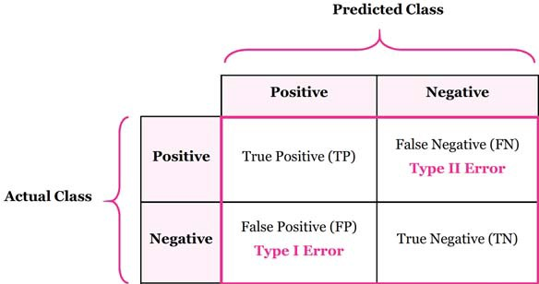
Confusion Matrix
A confusion matrix is a table that helps visualize the performance of a classification model.
The number of correct and incorrect predictions are summarized with count values and broken down by each class.

Slide 5
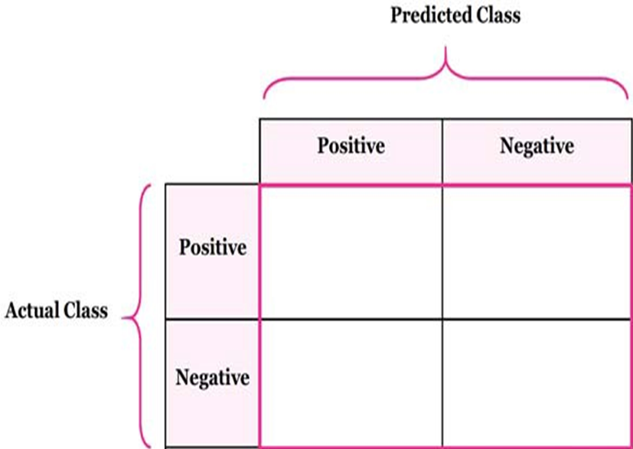
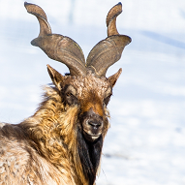
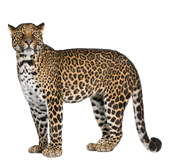
Confusion Matrix
True Positive
False Negative:
(Type 1 Error)
False Positive:
(Type 2 Error)
True Negative:
TP
FN
It’s a Markhor
It’s not a Markhor
FP
TN
It’s a Markhor
It’s not a Markhor

Slide 6
Confusion Matrix

Slide 7
Example of CM
Actual class\Predicted class | buy_computer (yes) | buy_computer (no) | Total
buy_computer (yes) | 6954 | 46 | 7000
buy_computer (no) | 412 | 2588 | 3000
Total | 7366 | 2634 | 10000
Can you answer these questions:
a) How many computers were bought?
b) What is the value of prediction about the sale of computers?
c) What is the numbers of computers which were actually bought and the algorithm also predicted it correctly?
d) What is the total number of samples in the data?
= 7000
= 7366
= 6954
= 10000

Slide 8
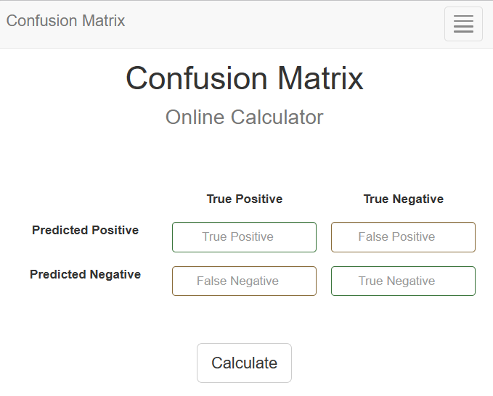
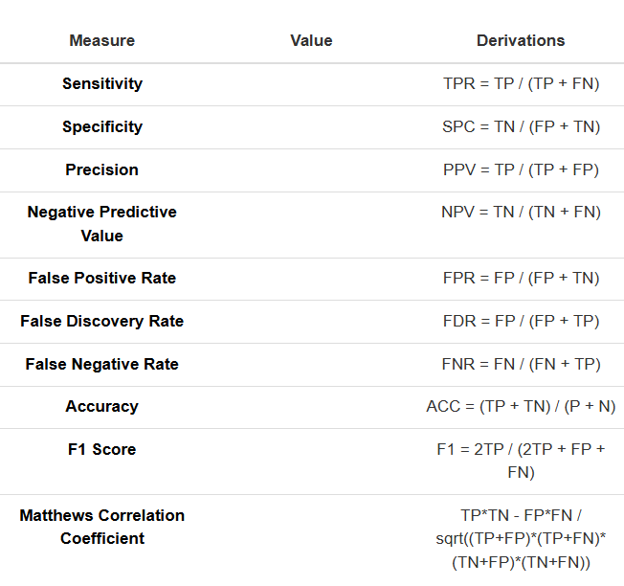
onlineConfusionMatrix
Confusion Matrix - Online Calculator Link

Slide 9
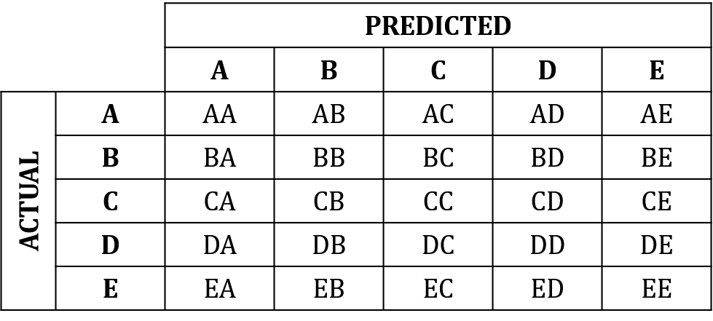
Confusion Matrix for Multiple classes
Let’s assume we have a 5-class problem with the classes A, B, C, D, and E and the following confusion matrix:

Slide 10
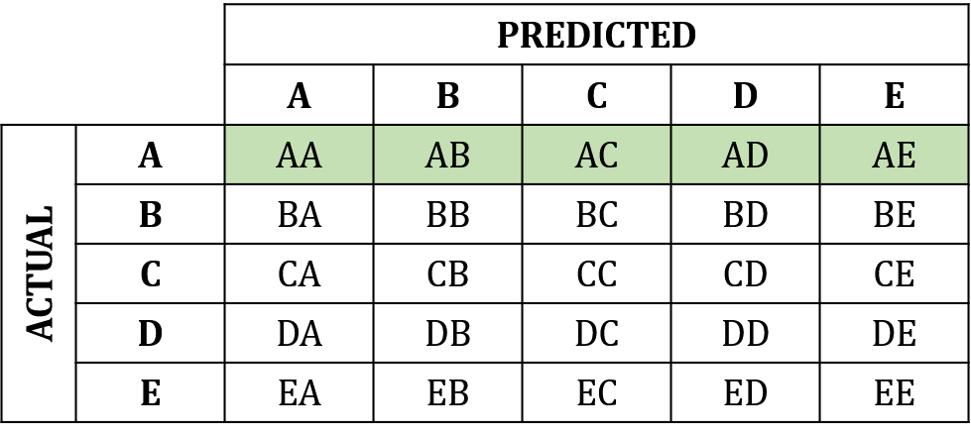
Confusion Matrix for Multiple classes
The Total number of test examples/Samples of any class would be the sum of the corresponding row (i.e. TP+FN for that class).
For example, for class A:

Slide 11
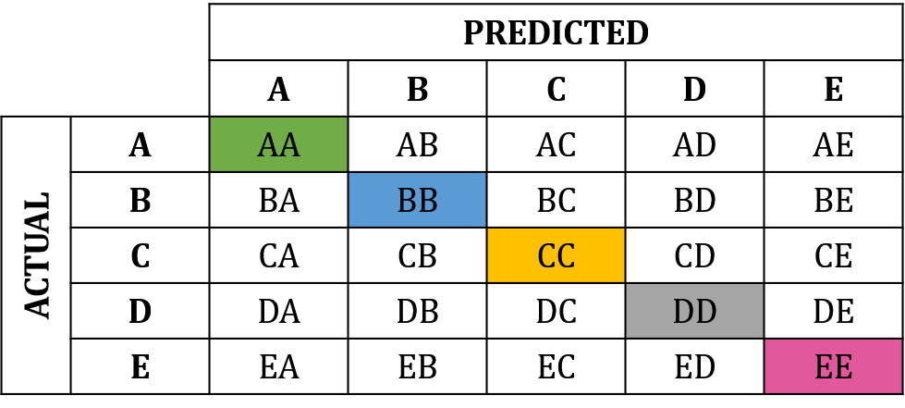
Confusion Matrix for Multiple classes
TP’s is the diagonal value.
For class A: AA
For class B: BB
For class C: CC
For class D: DD
For class E: EE

Slide 12
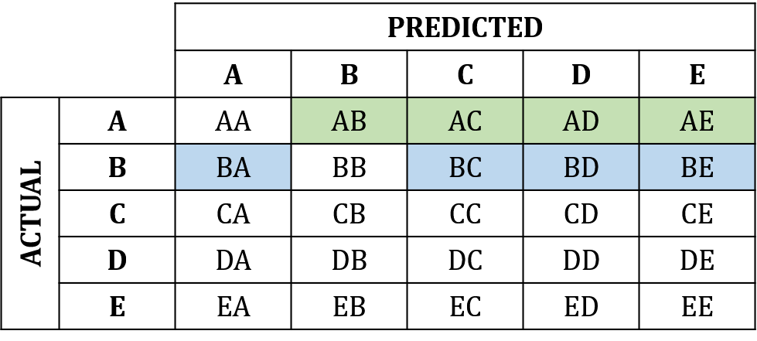
Confusion Matrix for Multiple classes
FN’s is the sum of values in the corresponding row (excluding the TP).
For class A: AB+AC+AD+AE
For class B: BA+BC+BD+BE

Slide 13
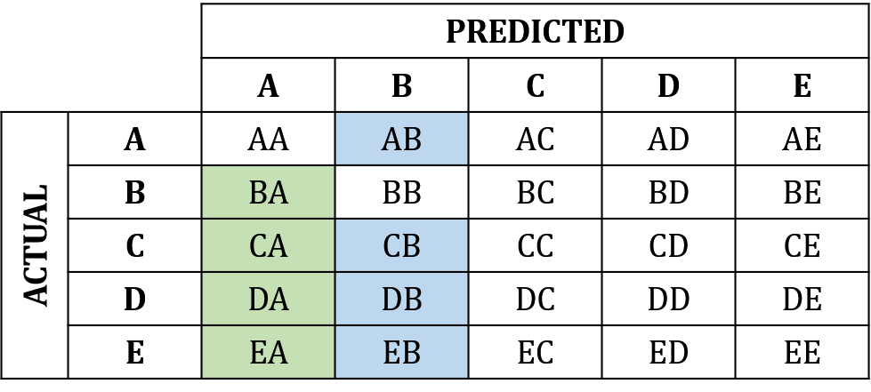
Confusion Matrix for Multiple classes
FP’s is the sum of values in the corresponding column (excluding the TP).
For class A: BA+CA+DA+EA
For class B: AB+CB+DB+EB

Slide 14
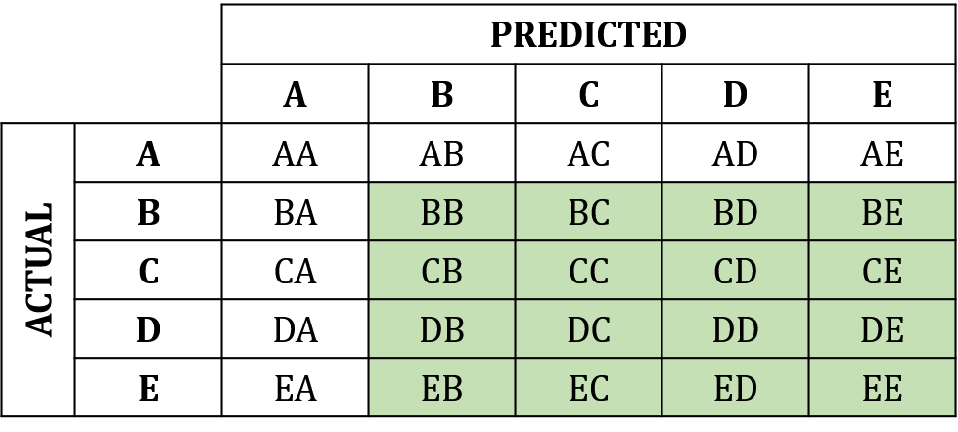
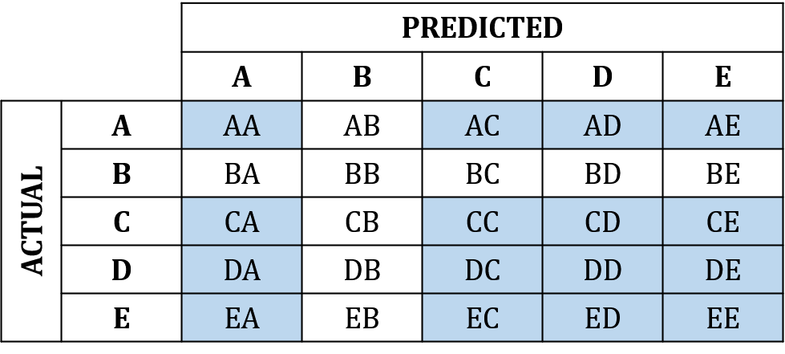
Confusion Matrix for Multiple classes
TN’s is the sum of all columns and rows excluding that class’s column and row.
For class A:
For class B:

Slide 15
Confusion Matrix for Multiple classes

Slide 16
1. Accuracy
The accuracy evaluation metric is one of the simplest and most widely used evaluation measures for the performance of classification models.
Accuracy is the ratio of correctly predicted records/ samples (both positive and negative) to the total number of testing records/ samples.
Range: Accuracy values range from 0 to 1, where:
0 means the model is always wrong.
1 (or 100%) means the model is always correct.
$$Accuracy=\frac{Number of correct predictions}{Total number of predictions}=\frac{(TP+TN)}{(TP+TN+FP+FN)}$$

Slide 17
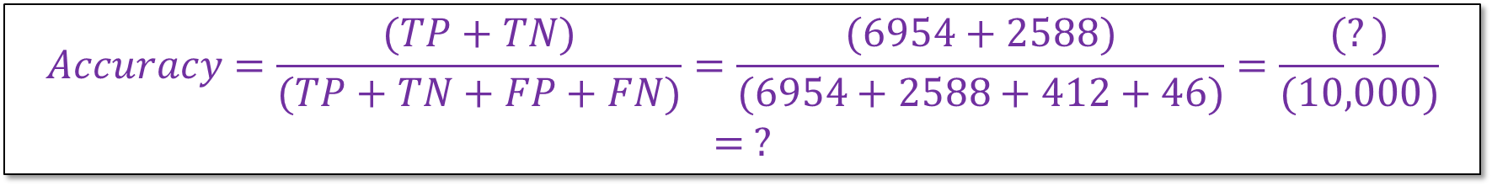
Example of Accuracy
 | buy_computer (yes) | buy_computer (no) | Total
buy_computer (yes) | 6954 | 46 | 7000
buy_computer (no) | 412 | 2588 | 3000
Total | 7366 | 2634 | 10000
$$Accuracy=\frac{(TP+TN)}{(TP+TN+FP+FN)}=\frac{(6954+2588)}{(6954+2588+412+46)}=\frac{(?)}{(10,000)}= ?$$
This algorithm has ___ % accuracy.

Slide 18

2. Recall
Recall is used to check how well a model finds all the true positive cases in a dataset.
It’s especially useful when the model missing positive cases (like failing to detect a disease) is a bigger problem than having a few extra false positives
Range: Recall values range from 0 to 1, where:
0 means the model missed all the positive cases.
1 (or 100%) means the model correctly found every positive case.
$$Recall=\frac{True Positives}{True Positive+False Negative}$$

Slide 19
Example of Recall
 | buy_computer (yes) | buy_computer (no) | Total
buy_computer (yes) | 6954 | 46 | 7000
buy_computer (no) | 412 | 2588 | 3000
Total | 7366 | 2634 | 10000
$$recall=\frac{(TP)}{(TP+FN)}=\frac{(6954)}{(6954+46)}=\frac{(6954)}{(7000)}= ?$$
This algorithm has ___ % recall.
Recall is valuable when the dataset is imbalanced.
In such cases, accuracy can be misleading, but recall focuses on finding all positive samples.

Slide 20

3. Precision
It shows how accurate the positive predictions of a model are.
It is useful when more important to avoid false positives (wrongly marking something as positive) than it is to find every positive case.
Range: Precision values range from 0 to 1, where:
0 means that all positive predictions are incorrect.
1 (or 100%) means that all positive predictions are correct.
$$Recall=\frac{True Positives}{True Positive+False Positive}$$

Slide 21
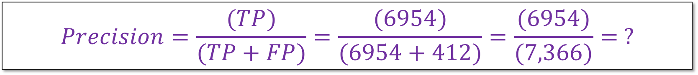
Example of Precision
 | buy_computer (yes) | buy_computer (no) | Total
buy_computer (yes) | 6954 | 46 | 7000
buy_computer (no) | 412 | 2588 | 3000
Total | 7366 | 2634 | 10000
$$Precision=\frac{(TP)}{(TP+FP)}=\frac{(6954)}{(6954+412)}=\frac{(6954)}{(7,366)}= ?$$
This algorithm has ___ % precision.
Recall is valuable when the dataset is imbalanced.
In such cases, accuracy can be misleading, but recall focuses on finding all positive samples.

Slide 22
4. F1-Score
The F1 Score is the harmonic mean of Precision and Recall.
Range: The F1-Score ranges from 0 to 1, where:
0 means either precision or recall is zero (perform poorly).
1 means both precision and recall are perfect (perform very well).
$$F1 Score=\frac{2×(Precison×Recall)}{Precison+Recall}$$

Slide 23
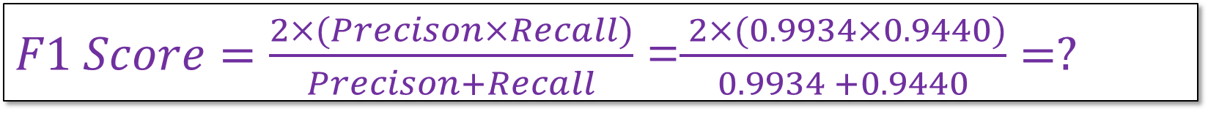
Calculating F1-Score
 | buy_computer (yes) | buy_computer (no) | Total
buy_computer (yes) | 6954 | 46 | 7000
buy_computer (no) | 412 | 2588 | 3000
Total | 7366 | 2634 | 10000
$F1 Score=\frac{2×(Precison×Recall)}{Precison+Recall}$ =$\frac{ 2×(0.9934×0.9440)}{0.9934 +0.9440}=?$
This algorithm has ___ F1-Score.

Slide 24
ROC Curve
It is the Receive Operating Characteristics curve.
It is a plot of the True Positive Rate (TPR) against the False Positive Rate (FPR).
True positive rate:
False positive rate (or Fallout):

Slide 25
ROC Explain
Go for the perfect classifier

Slide 26
ROC Example
Questions:
Which classifier is good for the value 0.2
Which one is good for the value of 0.42
Which one performs well for the value of 0.8
Which one you select?

Slide 27
Mean Absolute Error (MAE)
Absolute Error is the amount of Error in a measurement

Slide 28
Mean Square Error (MSE)
Another standard performance evaluation measure

Slide 29
Root Mean Square Error (RMSE)
Or Standard Deviation of the predicted Error

Slide 30
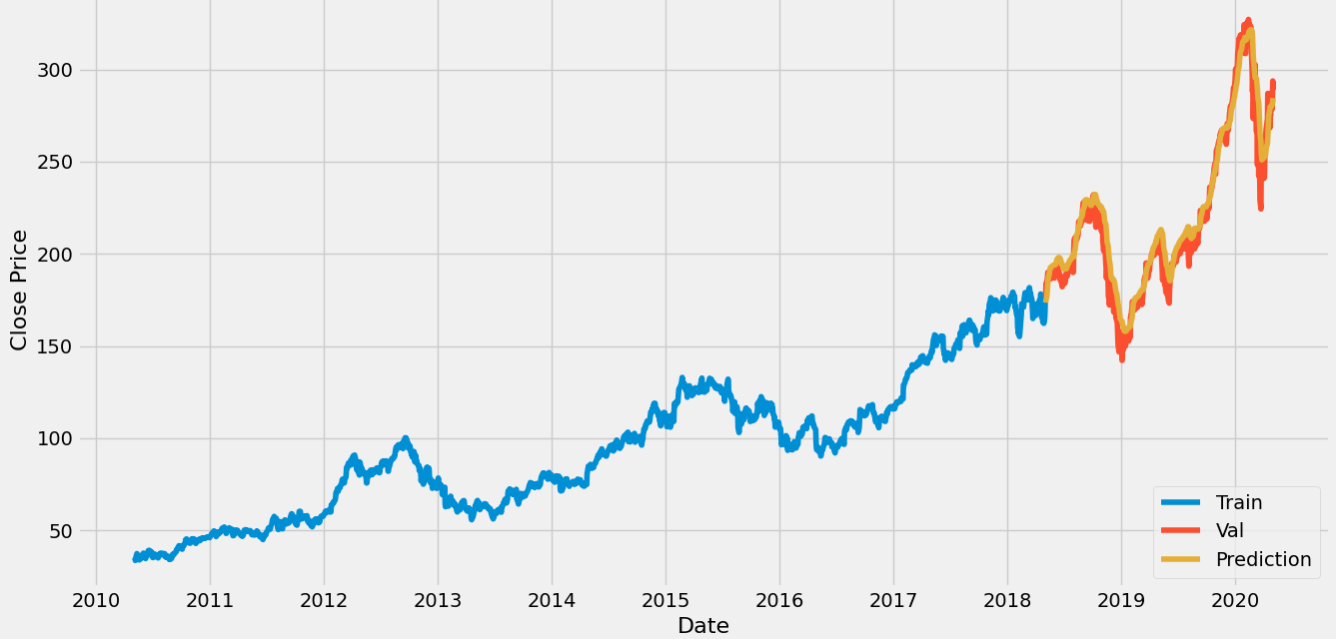
Example of price prediction

Slide 31

THE SECRET || LAW OF ATTRACTION (Audio: Hindi )
URL: THE SECRET || LAW OF ATTRACTION || HINDI VERSION || #mindset#reality
Total Duration: 01:30 Hrs

